Slide 1
Sentimental Recognition
on Yelp
Group 10
Reese Chen
Sam Chi
Mandy Huang
Kristy Weng
Ashley Wu

Slide 2
TABLE OF CONTENTS
01
04
MODEL DEMO
PROJECT OBJECTIVE
02
05
CHALLENGES
& LEARNING
METHODOLOGY
03
06
Q&A
DATA DESCRIPTION
Notes:
Each team will have 10 minutes for presentation, including Q&A.
Breakup: ~ 10 secs
Introduction - 1 min <>Project Description and Objectives
Present your approach - 3 mins. <>Methodology//1. Kristy ~p.6
Data Description - 1 min <>Data Descriptions//2. Mandy p.7~p.13
Demo the model - 1 min. <>
Challenges & Learnings - 1 min//3. Ashley p.14~p.19
Q & A - 3 mins

Slide 3
01
PROJECT OBJECTIVE

Slide 4

UNDERSTAND EMOTIONS IN YELP REVIEWS
Emotion Dataset
Yelp Review Data
Build multi-classification models using sentiment analysis
Identify positive and negative emotions from texts
Understand the sentiment of customers’ comments
Help establishments to recognize bad reviews
Notes:
Our project aims to utilize the emotion dataset to conduct sentiment analysis and build multi-classification models.
The emotion dataset allows us to identify positive and negative emotions from texts, which will later be used to predict the sentiment of yelp’s reviews.
We proposed this project because we thought this application would help establishments on Yelp to recognize the reviews that might negatively affect their reputation. Establishments can then take actions to improve their service and avoid harmful reviews in the future.

Slide 5
02
METHODOLOGY

Slide 6
ANALYSIS FLOW
Preprocess:
spaCy + custom stopwords
Feature extraction: CountVectorizer()/Tfidf Vectorizer() with unigrams and bigram
EDA:
class frequency, length, word cloud, word importance
STEP 1
STEP 2
STEP 3
STEP 4
STEP 5
Build
multi-classification models
Random Forest
Linear Support Vector Machine
Multinomial Naive Bayes
Logistic Regression
Feed 147 Yelp Restaurant reviews with self-labeled data
Notes:
Here shows the flow of the entire project. There are five steps.
For the emotion dataset, we used spacy and custom stopwords to preprocess data. We have done this for train, test and validation data.
In the second step, we used countvectorizer and tfidf vectorizer to convert our text data into numeric data and extract class features. Through this process, we can get the top correlated unigrams and bigrams for each category.
In the third step, we performed some exploratory data analysis, such as the graphs showing class frequency and length, word cloud, and word importance for each category.
After the preprocessing step and EDA, we used emotion dataset to train the multi-classification models. There are four models we used, which are Random Forest, Linear SVM, Multinomial Naive Bayes and Logistic Regression. To get the better performance for each model, we tried to tune the parameters to see if we can get a higher accuracy in the test set.
And finally, we fed 147 Yelp review data that we manually labeled the emotions to test our model performance.

Slide 7
03
DATA DESCRIPTION

Slide 8

EMOTIONS DATASET
Kaggle Emotion Dataset
Sample Data
6 Emotion Classes
16,000 trains
2,000 tests
2,000 validation
“i was dribbling on mums coffee table looking out of the window and feeling very happy;joy”
Surprise, Love, Joy, Fear, Sadness, Anger
Notes:
We used the emotion dataset from Kaggle, with 16,000 training and 2,000 each for test and validation. The output variable has 6 classes including surprise, love, joy, fear, sadness and anger. So the sample document like ‘i was dribbling on moms coffee table looking out of the window and feeling very happy’ will be labeled as joy.

Slide 9
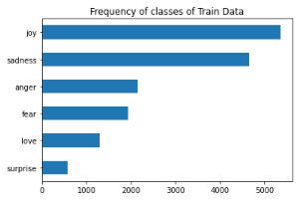
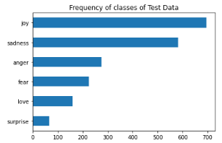
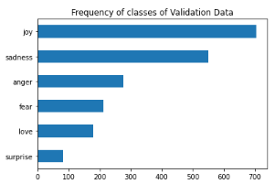
UNBALANCED CLASSES
The most frequent classes are “joy” and “sadness”
The rare ones are “love” and “surprise”
Notes:
We first examized the categories distribution in each set, and found our data has some unbalanced problem where joy and sadness categories are most frequent and love and surprise are rare.

Slide 10
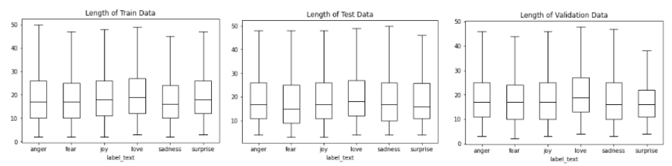
BALANCED SENTENCE LENGTH
Avg. length is 19 words
Common range from 10 to 25 words
Notes:
We also checked the sentence lengths of each category, and this time data is more balanced. The avg length is 19 words and common range is from 10 to 25 words.

Slide 11
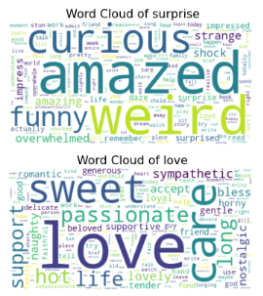
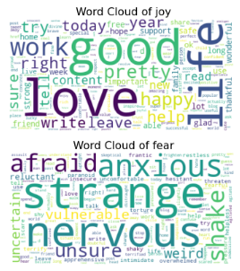
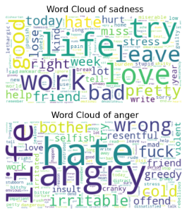
IN TRAINING SET - WORD CLOUD
Positive words in positive classes, negative words in negative classes
“weird” is positively shown in “surprise”, while “strange” is negatively shown in “fear”
“work”, “life” are shown in “sadness”
Strong emotion words such as “love”, “amazed”, “hate”, and “angry”
Notes:
And then we dived into the documents to see word distribution in each category, so we generated word clouds for each class.
It’s quite make sense that positive words such as amazed, good, love…are in positive classes, and neg words such as anxious, hate, angry…are in neg classes. We found it interesting that ‘weird’ is a common word in the surprise category while strange is strongly shown in fear category. Another interesting finding is that words such as life, work and love are in sadness category.
There is no doubt that most positive words appear in positive classes and vice versa. It is interesting to notice that the word “weird” is a common word showing in the class “surprise” while “strange” is negatively shown in class “fear”. Another point of interest is that the words such as “work” and “life” are shown in class “sadness”. From the word cloud, we could also feel the strong emotion words such as “love”, “amazed”, “hate”, and “angry” in classes.

Slide 12
IN TRAINING SET - TOP 5 WORD IMPORTANCE
 | CountVectorizer(min_df=0.0001, ngram_range=(1,1)) | CountVectorizer(min_df=0.0001, ngram_range=(1,2)) | TfidfVectorizer(min_df= 0.0001, ngram_range=(1,1), sublinear_tf=True)) | TfidfVectorizer(min_df= 0.0001, ngram_range=(1,2), sublinear_tf=True))
surprise | funny, surprised, impressed, curious, amazed | wake daze, remember shocked, like admit, daze confuse, pretty impressed | funny, surprised, impressed, curious, amazed | help curious, remember amazed, impressed work, daze confuse, pretty impressed
love | naughty, loyal, nostalgic, horny, sympathetic | skin lovely, fond memory, love love, like naughty, like care | delicate, naughty, horny, nostalgic, sympathetic | like hot, fond memory, love love, like naughty, like care
joy | confident, glad, content, satisfied, successful | cool cool, like perfect, like worthwhile, like important, like valuable | rich, brave, glad, successful, content | self assure, like worthwhile, like perfect, like valuable, like important
fear | unsure, uncertain, reluctant, apprehensive, vulnerable | remember terrified, begin anxious, paranoid like, like paranoid, absolutely terrified | uncertain, unsure, apprehensive, insecure, vulnerable | hesitant post, nervous anxious, begin anxious, paranoid like, like paranoid
sadness | awkward, lethargic, punish, melancholy, miserable | like worthless, target blank, like fake, like punish, like miss | homesick, awkward, punish, miserable, gloomy | like doom, like worthless, like fake, like punish, like miss
anger | angry, dangerous, resentful, greedy, irritable | like greedy, like selfish, like rude, like heartless, like bother | irritated, resentful, cranky, irritable, greedy | like stubborn, like greedy, like heartless, like selfish, like bother
Notes:
Besides using word clouds, we use CountVectorizer() and TfidfVectorizer() and apply unigrams and bigram to the text to understand the word importance. For most of the cases, we find similarity for both feature extraction, but there is still a slight difference on the result of word importance.
And here are the top 5 word importance in each category when using diff vectorizers.

Slide 13
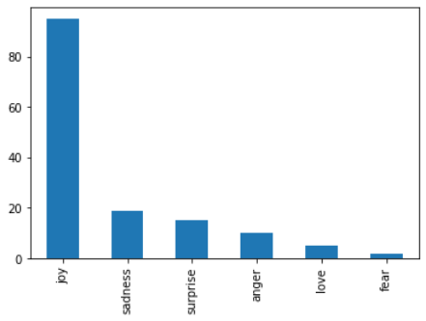
YELP DATASET
Self-labeled Yelp Review
Sample Data
147
“Love going here for happy hour or dinner! Great patio with fans to beat the StL heat! Also...very accomodating at this location. I like the Veal Milanese but with mixed greens instead of pasta! they'll modify the menu to suit your taste!”
Joy | Sadness | Surprise | Anger | Love | Fear
96 | 19 | 15 | 10 | 5 | 2
Notes:
After we build our model, we aim to apply it into yelp review data, so we manually labeled 147 yelp review data into our six categories.

Slide 14
04
MODEL DEMO

Slide 15
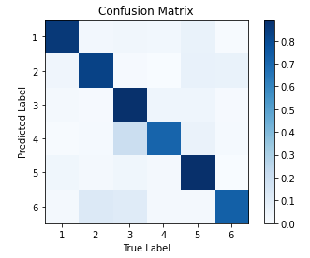
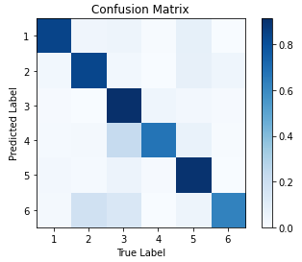
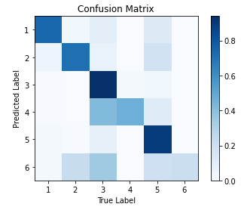
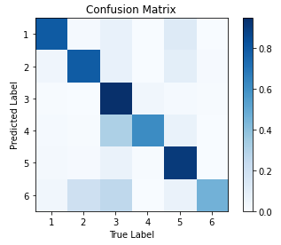
Model - CountVectorizer()
Linear SVM
Random Forest
Multinomial Naive Bayes
Logistic Regression
Avg. F1: 0.858
Avg F1: 0.8619
Avg F1: 0.8125
Avg F1: 0.8585
* 'surprise':1, 'love':2 , 'joy':3 , 'fear': 4, 'sadness': 5, 'anger':6

Slide 16
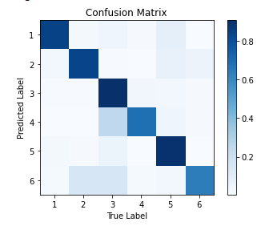
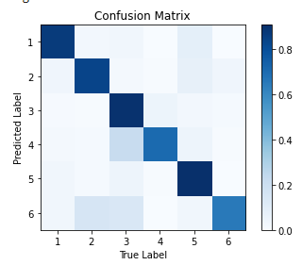
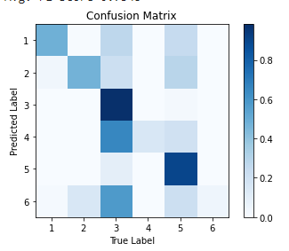
Model - TfidfVectorizer()
Linear SVM
Random Forest
Multinomial Naive Bayes
Logistic Regression
Avg. F1: 0.8620
Avg F1: 0.866
Avg F1: 0.7345
Avg F1: 0.8515
* 'surprise':1, 'love':2 , 'joy':3 , 'fear': 4, 'sadness': 5, 'anger':6

Slide 17
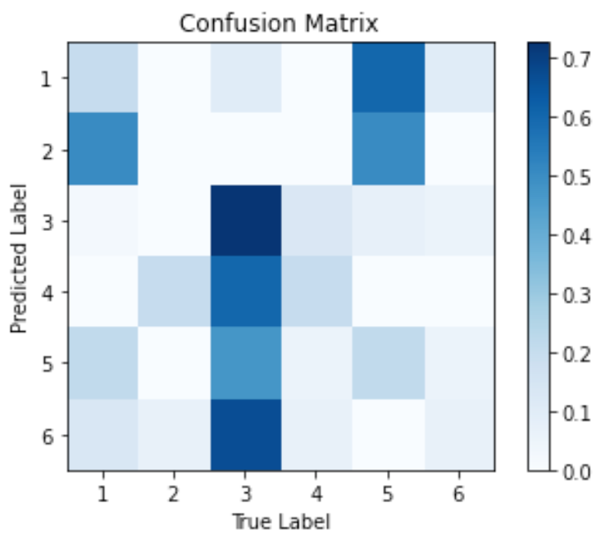
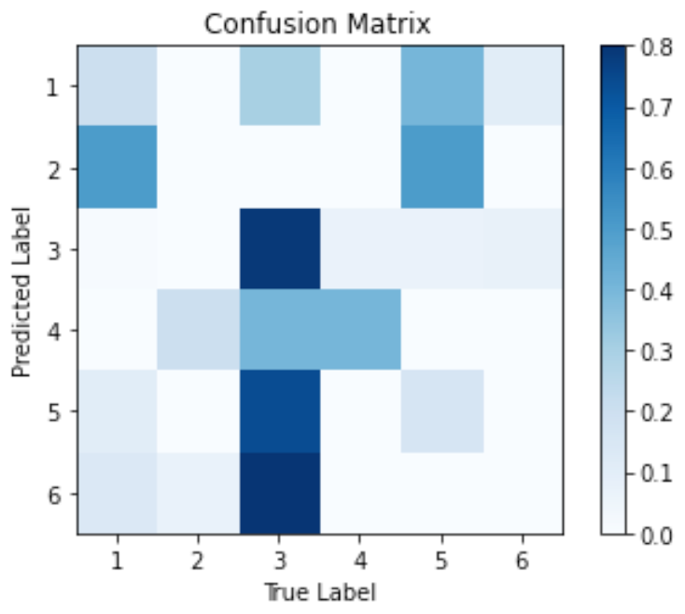
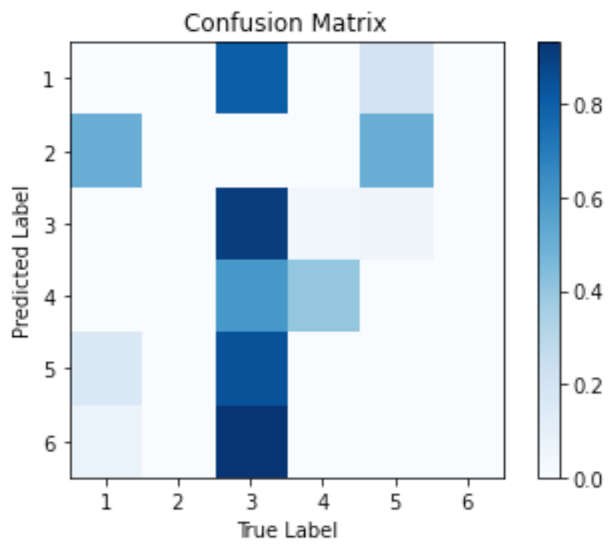
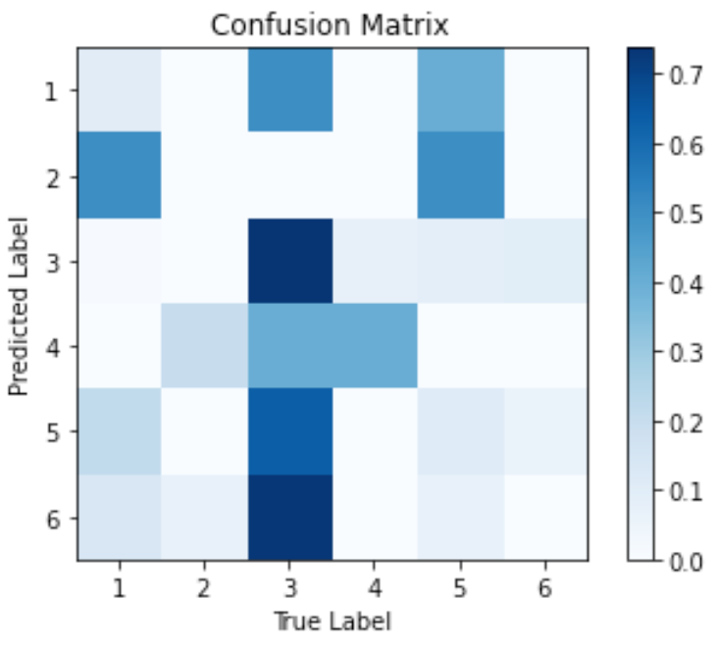
Yelp Data - CountVectorizer()
Linear SVM
Random Forest
Multinomial Naive Bayes
Logistic Regression
Avg. F1: 0.5274
Avg F1: 0.5616
Avg F1: 0.6027
Avg F1: 0.5137
* 'surprise':1, 'love':2 , 'joy':3 , 'fear': 4, 'sadness': 5, 'anger':6

Slide 18
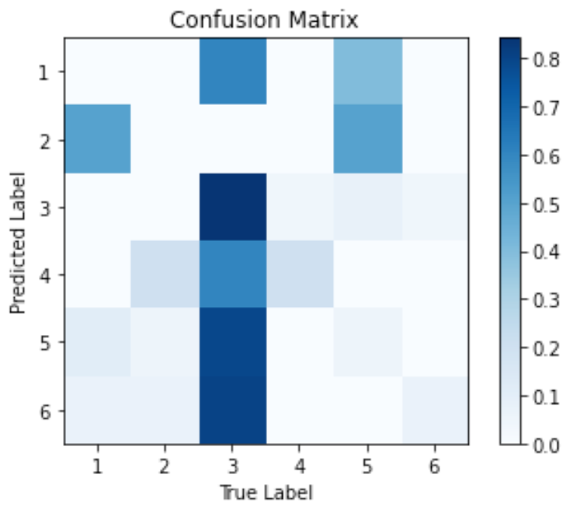
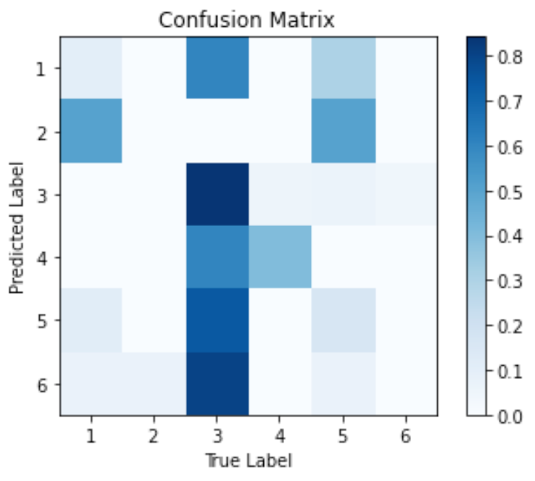
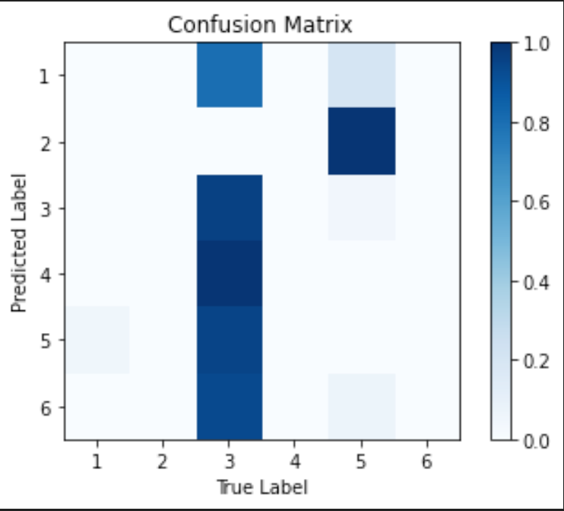
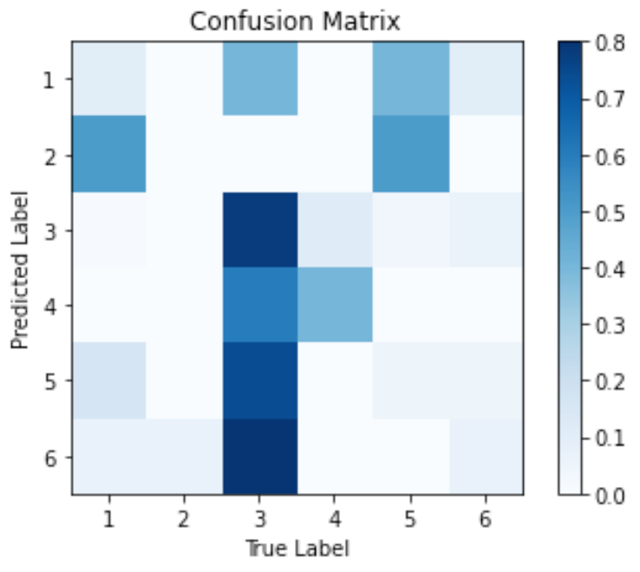
Yelp Data - TfidfVectorizer()
Linear SVM
Random Forest
Multinomial Naive Bayes
Logistic Regression
Avg. F1: 0.5685
Avg F1: 0.5891
Avg F1: 0.6233
Avg F1: 0.5411
* 'surprise':1, 'love':2 , 'joy':3 , 'fear': 4, 'sadness': 5, 'anger':6

Slide 19
05
CHALLENGES
& LEARNING

Slide 20
Challenge
Learning
Label class inconsistency: self-labeled 147 Yelp data
Yelp review tend to be longer than data trained in the model
Leap from traditional Yelp sentiment analysis to emotion understanding by combining two datasets and our multi-classification models
More business value for restaurant owners to understand how customers feel about their dining experience

Slide 21
06
Q&A

Slide 22
THANKS!

